Slide 1
Agenda
Node JS
ES6
React JS
Flux
Redux
Grommet

Slide 2
PRE-REQUISITE
Basic Knowledge of JavaScript.
Basic Knowledge of HTML.
Basic understanding of Node JS (Preferred).

Slide 3
NODE JS
What Is Node JS?
Node JS Provides JavaScript runtime environment.
Node.js is a very powerful JavaScript-based framework/platform built on Google Chrome's JavaScript V8 Engine.
It is used to develop I/O intensive web applications like video streaming sites, single-page applications, and other web applications.
Node JS uses an event-driven, non-blocking I/O model.
Node Js comes with some inbuilt functionality made available through core modules like:
http, fs, event, path, url, util etc.

Slide 4
What is NPM?
NPM stands for Node Package Manager. It serves two main functionalities:
Online repositories for Node packages/modules
Command line utility to install Node.js packages, do version management and dependency management of Node.js packages
Install a Node module: npm install <Module name>
Global vs Local install:
global installation installs module where node JS is install and is accessible from any where.
Local installation installs module in current directory creating a folder named node_modules. It is accessible only from folder where it is installed.

Slide 5
EventEmitter Class
Many object in Node emit events. All objects which emit events are the instances of events.EventEmitter
EventEmitter Class is inside “event” core module of Node.
This Class has got many methods. Some of which are:
addListener(event, listener)
on(event, listener)
removeListener(event, listener)
removeAllListeners([event])
emit(event, [arg1], [arg2], [...])
Class Methods:
listenerCount(emitter, event)

Slide 6
ECMAScript 6
Let and const variable:
In javaScript we define variable using var keyword. var variable function scoped.
In ES6 we have two more keywords, let and const. these two variables are block scoped.
Refer “let and const.js” file for example
Destructuring:
ES6 introduces a new syntax which makes it really easy to create variables based on Objects and arrays.
Refer “destructuring.js” file for example
Arrow Function:
ES6 introduces a new syntax for function declaration called arrow function.
Arrow functions enable developer to cleaner and shorter code. Callback functions use arrow function syntax frequently.
Refer “arrow.js” file for example

Slide 7
ECMAScript 6
Classes:
ES6 introduces concept of class as available in traditional OOP languages. This new syntax make writing of code much cleaner.
Refer “classes.js” file for example
Modules:
Using modules we break our codes into multiple file and reuse them as and when required. We can span our business logic into multiple modules instead of one single file. It is necessary to export [ class, function or variable] from module in order to use in file which is importing it.
Refer “module1.js” and “main.js” file for example

Slide 8
REACT JS
What is React JS?
React is front end library developed by Facebook. It's used for handling view layer for web and mobile apps. React JS allows us to create reusable UI components. It is currently one of the most popular JavaScript libraries and it has strong foundation and large community behind it.
React uses virtual DOM which is JavaScript object. This will improve apps performance since JavaScript virtual DOM is faster than the regular DOM.
Setting up React JS
Babel: Babel is a javascript Library which converts ES6 codes to ES3 which all browsers can understand.
Webpack: webpack is module bundler. It can also convert ES6 to ES3 using babel as loader. We need to provide configuration in a file named “webpack.config.js” for webpack giving entry point, output file name, loader configuration etc

Slide 9
REACT JS
Component class
React is all about Components. React provides Component class for building our own custom components. We need to extend this component class for building own components.
It has got many methods:
constructor()
render() : This method must be overridden.
Lifecycle methods:
componentWillMount()
componentDidMount()
componentWillUnmount()
componentWillReceiveProps()
componentWillUpdate()
componentDidUpdate()

Slide 10
REACT JS
State and props:
State and props are used for rendering dynamic values.
Main difference between state and props is that, state can be changed while props cannot be changed.
We can change/modify sate using setState() method of Component class.
Props values are passed through attributes of the Component.

Slide 11
REACT JS
Navigation using React Router
URL | Component
/ | Dashboard
/inbox | Inbox
/contact | Contact
/about | About

Slide 12
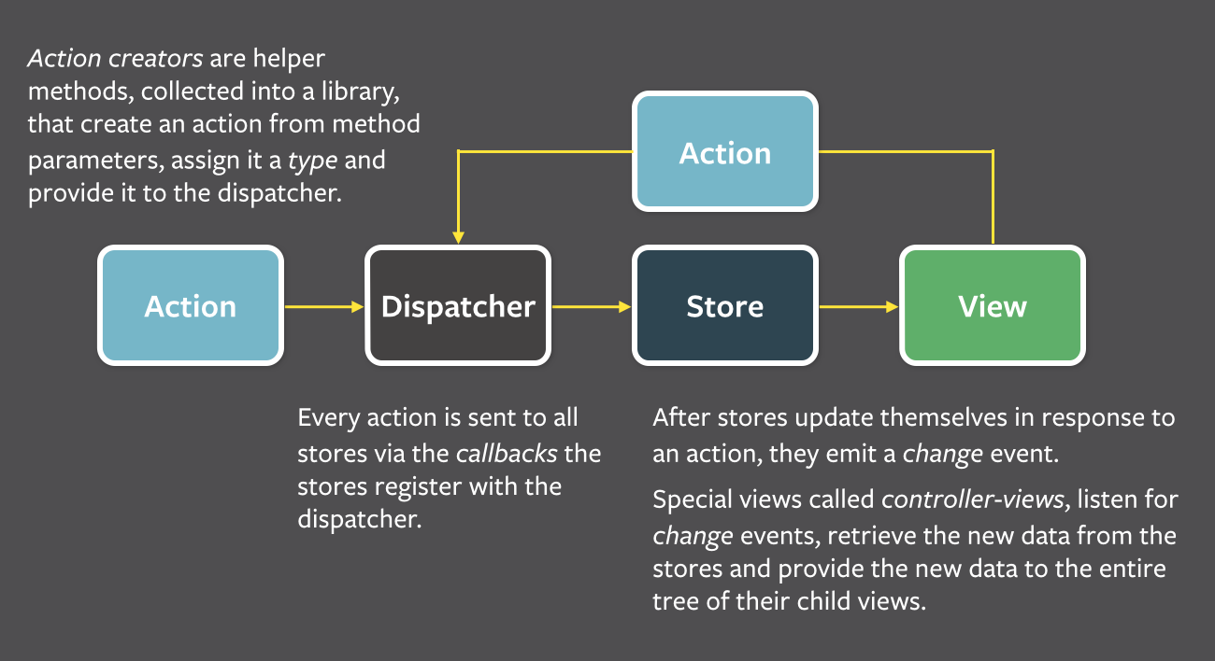
Flux Architecture

Slide 13
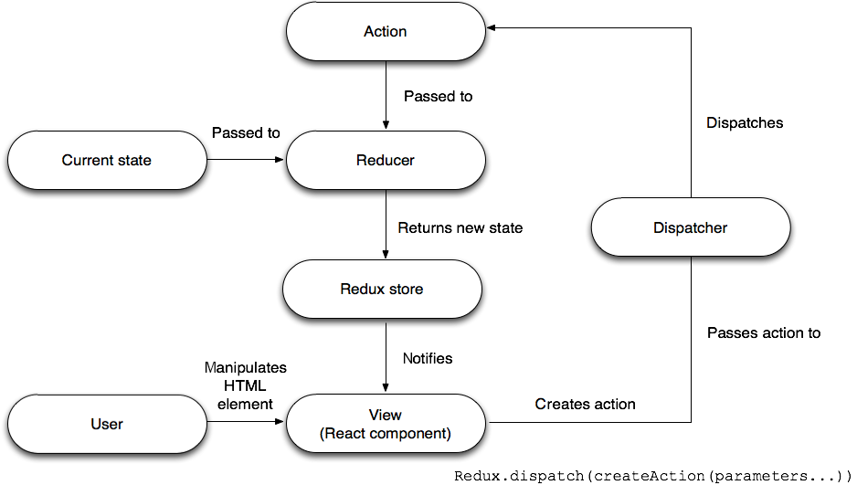
Redux Architecture

Slide 14
GROMMET
What is Grommet?
Grommet is a framework based on React JS. React JS Provides functionality of creating Components but we need to create those components. Grommet simplifies our work providing ready made general use case Components.
Grommet development environment setup:
There is JavaScript library called grommet-toolbox which simplifies the development environment setup for Grommet. It runs on top of gulp.
Gulp is build/task runner for development.

Slide 15
Getting started with grommet
We can quickly get started with grommet using grommet-cli.
Install grommet-cli globally: npm install grommet-cli –g
Create a sample application: grommet new sample-app
The development environment for grommet is setup in this Sample Application. We can always start with this app and make changes further as required.

Slide 16
Summary
Node is used as javascript development environment.
We will be writing all our codes in ECMAScript6.
We will break our entire application into multiple modules to keep the code clean
We transpile our ES6 codes to ES3 using babel.
We use webpack for module bundling.
React helps us creating our own components with additional functionality.
We render dynamic data in React using state and props.
We manage data flow in react using Flux or Redux.
Flux is suitable for small application while Redux is suitable for Large/Complex Applications.
Grommet provides ready made general use case Components.
Grommet Toolbox is used for managing Grommet development environment setup.

Slide 17
References
Node:
http://www.tutorialspoint.com/nodejs/
https://nodejs.org/api/
ECMAScript 6
http://ccoenraets.github.io/es6-tutorial/
http://egorsmirnov.me/2015/05/22/react-and-es6-part1.html
Webpack
https://medium.com/@dabit3/beginner-s-guide-to-webpack-b1f1a3638460#.v4jlbls31
http://webpack.github.io/docs/
React JS
https://www.codementor.io/reactjs/tutorial/beginner-guide-setup-reactjs-environment-npm-babel-6-webpack
https://facebook.github.io/react/docs/hello-world.html
https://www.youtube.com/watch?v=MhkGQAoc7bc&list=PLoYCgNOIyGABj2GQSlDRjgvXtqfDxKm5b
Grommet
https://grommet.github.io/hpe/docs/get-started
Tutorilal Sample Applications
https://github.com/zahid7292

Slide 18
Questions?

Slide 19
Thank you…

